Slide 1
Implementing Interpersonal Communication in the Classroom
Brandy Shirely DePriest, Ph.D.
Trine University

Slide 2
Spend 5 or so minutes getting to know your neighbor(s).
(Get a book or movie recommendation!)
(Get a movie or book recommendation)

Slide 3
A journey we take together
Notes:
Educators at teaching institutions
Commitment to the student
Lifelong learners
Using a variety of tactics to foster student success

Slide 4
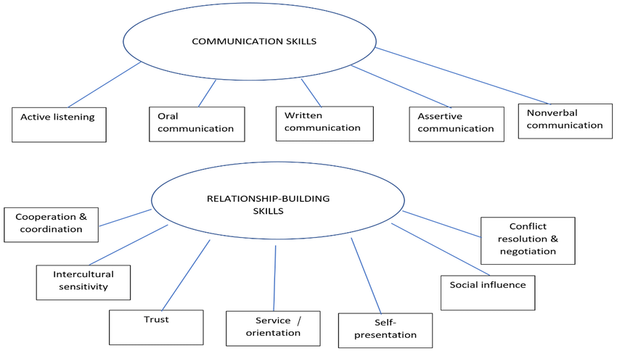
What is Interpersonal Communication?
Notes:
https://www.ncbi.nlm.nih.gov/books/NBK84226/table/ch3.t1/?report=objectonly

Slide 5
Why is interpersonal communication important?
Enhanced educational experiences
Connections with others
Empathy and understanding
Problem-solving
Future professional success
Improved learning environment
Participation, engagement, collaboration
Notes:
Connections with others: peers, professors, professionals
Enhance educational experiences
Promotes active participation, engagement, and collaboration
Improve the learning environment

Slide 6
Can everyone learn interpersonal skills?
Notes:
What about neurodivergent students? How can we accommodate their needs?

Slide 7
The world is a different place, which changes how we understand (and teach) interpersonal skills
Notes:
Reluctance of covid students in the classroom. Taking the backseat. Apprehension about involvement
Now is more vital than before because we need to pull them back. No longer living behind masks.

Slide 8
Activities
Non-Verbal Communication
Empathy and Perspective-Taking
Active Listening
Active listening is a fundamental aspect of effective communication. Incorporate activities that cultivate active listening skills, such as small group discussions and role-playing exercises.
Non-verbal cues, such as body language and facial expressions, play a significant role in communication. Include activities that focus on non-verbal communication, such as analyzing videos or engaging in non-verbal communication exercises.
Developing empathy and perspective-taking skills helps students understand others' viewpoints and promotes effective communication. Incorporate activities that encourage students to step into someone else's shoes and consider alternative perspectives.
Notes:
Listening: Active listening is a fundamental aspect of effective communication. Encouraging students to actively listen to their peers and instructors promotes understanding and fosters empathy. Instructors can incorporate activities that cultivate active listening skills, such as small group discussions and role-playing exercises.

Slide 9
Activities
Constructive Feedback
Cultural Competence
Providing constructive feedback is essential for growth and improvement in interpersonal communication. Incorporate activities that involve peer feedback, allowing students to practice giving and receiving feedback in a respectful and constructive manner..
In an increasingly globalized world, cultural competence is crucial for effective communication. Instructors can include lessons that promote cultural awareness, respect, and understanding.

Slide 10
Pair and Share
Divide students into pairs and provide them with a topic or question to discuss. Each student will have a designated time to share their thoughts and ideas while the other actively listens. Afterward, the roles switch, allowing both students to practice active listening skills.
Tactics
Think-Pair-Share
Incorporating active listening activities in your classroom can significantly enhance students' interpersonal communication skills. Here are a few strategies and activity ideas to promote active listening:
Begin by presenting a thought-provoking question or scenario to the class. Ask students to take a few moments to think about their response individually. Then, have them pair up with a partner to share their thoughts and actively listen to their partner's response. Finally, invite a few pairs to share their discussion with the whole class.
Listener’s
Reflection
After a class discussion or lecture, ask students to reflect on what they learned by writing a brief summary or key points from the discussion. Emphasize the importance of actively listening and capturing the main ideas. This activity encourages students to process and synthesize information while practicing active listening skills.

Slide 11
Role Playing
Assign students different roles or characters and provide them with a scenario to act out. During the role-play, students must actively listen to their fellow actors' lines and respond accordingly. This activity promotes active listening, empathy, and understanding of different perspectives.
Tactics
Listening Circles
Incorporating active listening activities in your classroom can significantly enhance students' interpersonal communication skills. Here are a few strategies and activity ideas to promote active listening:
Arrange the classroom in a circle and pose a question or topic for discussion. Pass an object (e.g., a ball) around the circle, allowing each student to speak while others actively listen. This activity encourages students to focus on the speaker, practice active listening, and engage in meaningful dialogue.
Icebreaker
Activities
Start the class with icebreaker activities that require students to interact with each other, such as sharing their hobbies or discussing their favorite books.

Slide 12
What are some other ways we can help students?
Notes:
Spend a few minutes brainstorming with your neighbor(s). What are some activities that we can use to improve student interpersonal communication skills?

Slide 13
Group Projects: Assign group projects that require collaboration and communication. This can help students learn to work together and express their ideas effectively.
Class Discussions: Facilitate class discussions where students can share their thoughts and opinions on different topics. Encourage active listening and respectful communication.
Peer Feedback: Encourage students to provide constructive feedback to their peers. This can help them communicate their observations and suggestions in a supportive manner.
Create a Safe Environment: Foster a safe and inclusive classroom environment where students feel comfortable expressing themselves without fear of judgment.
Other Ideas?
Notes:
Spend a few minutes brainstorming with your neighbor(s). What are some activities that we can use to improve student interpersonal communication skills?

Slide 14
Conclusion
Developing skills in interpersonal communication is vital for students across various fields of discipline.
By emphasizing the importance of effective communication and implementing strategies to improve communication skills in all types of classrooms, students can enhance their success and learning outcomes.

Slide 15
Thank you very much!

